Slide 1
SWMS Review Meeting
Aug.2024

Slide 2
ISD progress report
Scheme and UAT schedule
Agenda

Slide 3
ISD
progress report

Slide 5
PROJECT COMPONENTS
1
BUDGET
UNDER
Equipments no issue. OCS fee under
202K/250K.(Plan: 30K Aug-Sep)
2
RESOURCES
ON TRACK
Aug release 1, Sept release 1 member
3
TIMELINE
RISKS
New function, new issue
4
SCOPE
RISKS
Adding E-chop, Convert stock

Slide 7
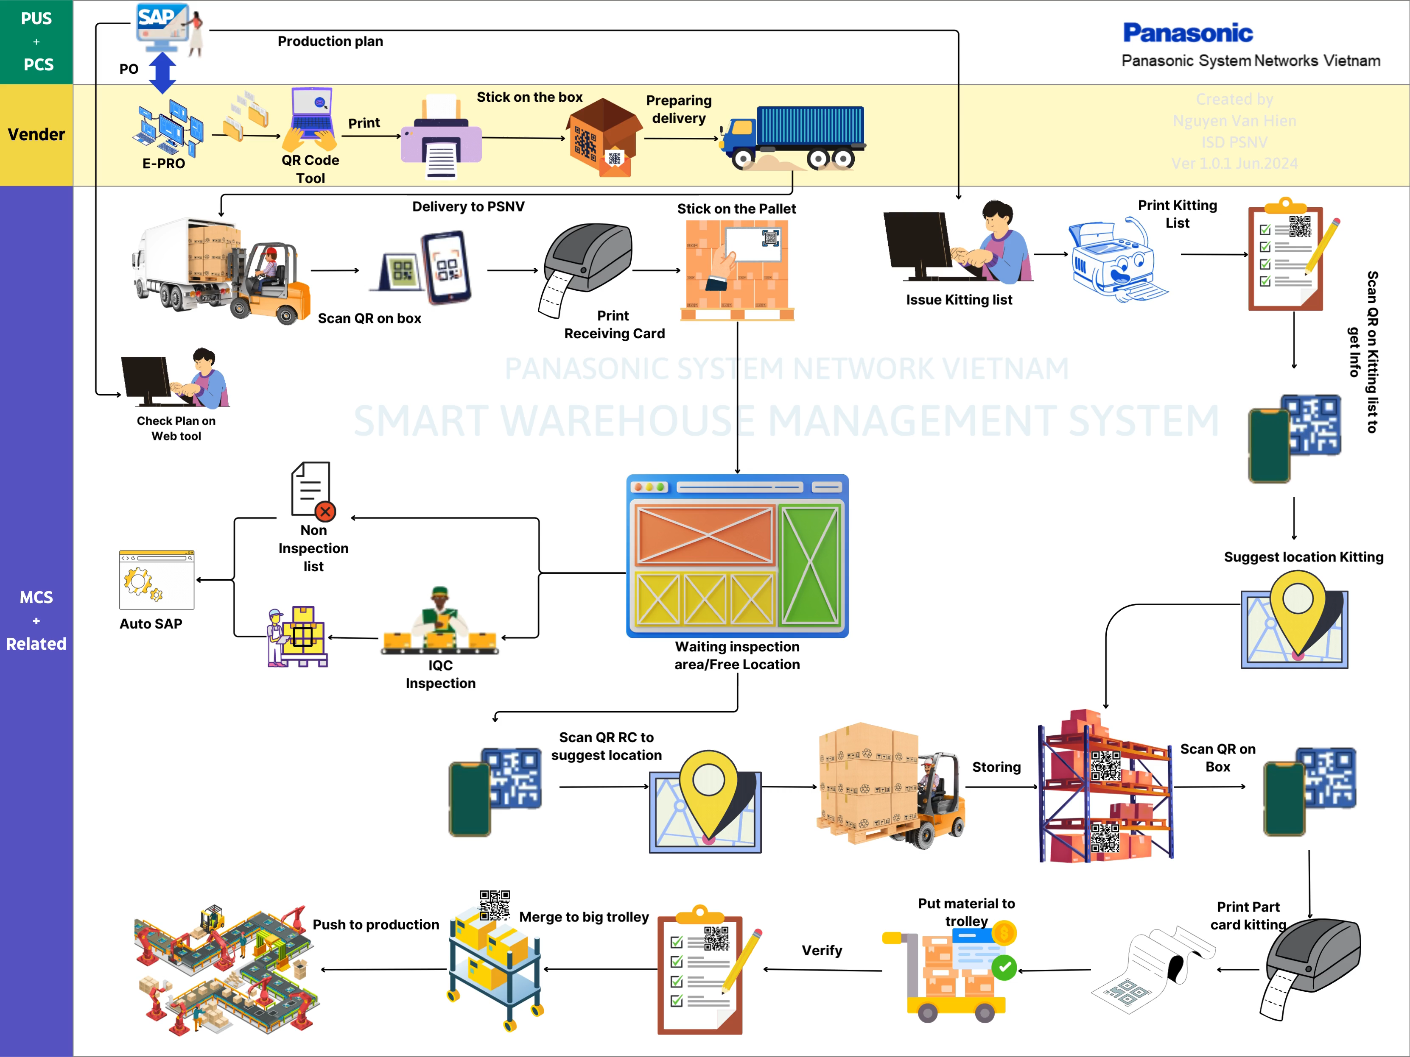
RECEIVING
GO-LIVE
UAT
TESTING

Slide 8
Project Timeline
Until 10 Aug
Milestone 1
Milestone 2
Milestone 4
Milestone 3
Milestone 5
Group Function | Status | Oct | Nov | Dec | Jan | Feb | Mar | Apr | May | Jun | Jul | Aug | Sep | Oct | Nov
Receiving | 100%
Storing, E-map | 100%
Kitting - Supply | 90%
Inventory, Report | 75%
SIT, UAT, Go-live | -
Document, Develop
UAT
Trial
Go-live
Storing
Emap
UAT
Kitting
E-map
UAT
Inventory
Report
UAT
Trial
SIT
Go-live

Slide 9
Scheme and
UAT schedule

Slide 10


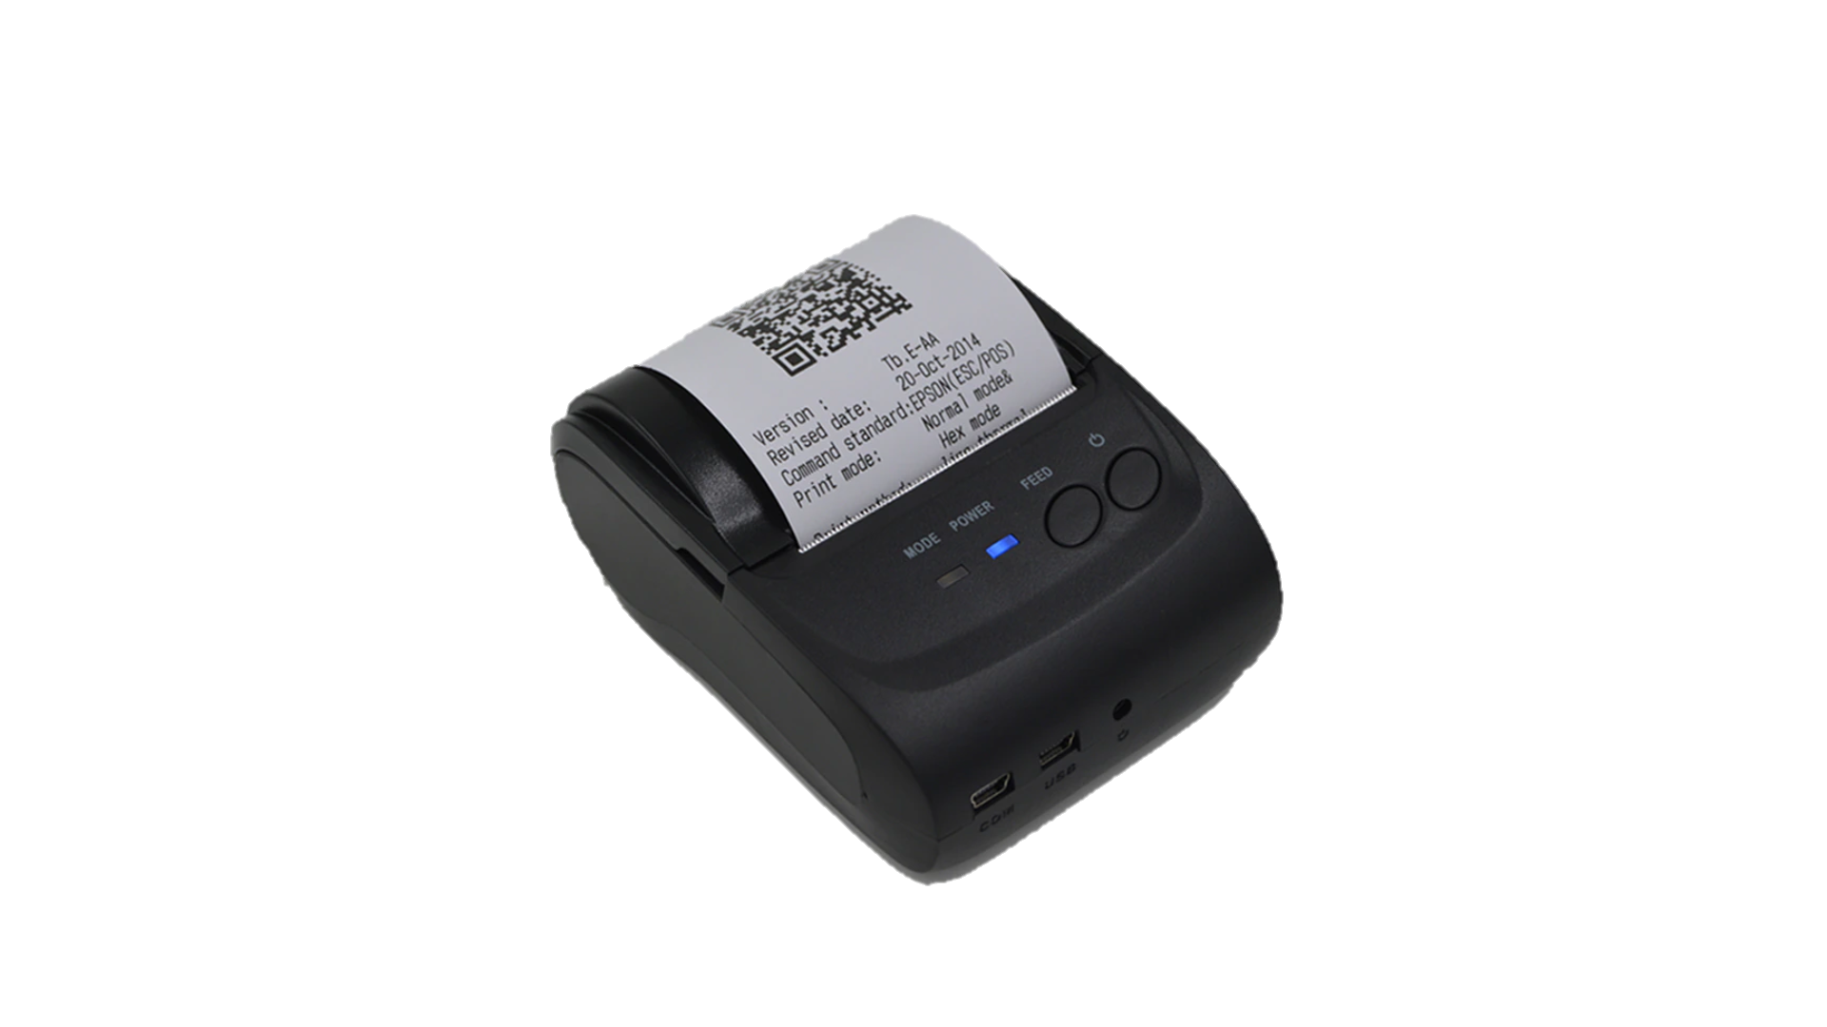
HOW TO CONVERT STOCK TO SWMS
1/3
Convert stock meaning: Update new SWMS concept for current stock & Apply parallel 2 system for new delivery
GOOD RECEIPT
STORING
KITTING
Issue unique QR code
E-map
store
Just transfer
OCR
Type 1
(for unique QR):
- Verify by unique box
- Issue qty from each box
no QR code
5% ~ 500 items
Paste to 100% box
2
New type
Receiving card
Key in position
Scan 100% box
Up to date
Have QR code
(unique)
84% ~ 7,860 items
paste
Smart WH
system
SWMS CONCEPT
Scan QR
(Unique)
1
Type 2
(for non unique QR):
- Verify by
Receiving card
- Issue qty from 1 lot
Have QR code
(Non unique)
11% ~ 1100 items
direct
print
Kitting
plan
Scan QR
(non unique)
E-map
Suggest position
There 2 points of current stock need to change to new concept
1
2
1
Add new Receiving card for all lot
2
Key in position to E-map
Current
Receiving card
Use together
E-map
store
Up to date
Print new RC
None QR code
Have QR code
Key in
Convert stock scheme
Trial GR & Store
Trial kitting & Supply
GO-live
New delivery
Moving part
Convert stock
Non/slow moving
Moving part
Balance stock
GR & store
Run parallel 2 systems
Run parallel 2 systems
Run new system
Kitting
Run current system
New system [full run] - Current system [parallel]
Run new system

Slide 11
Trial & Go-live history
2/3
1. UAT strategy: UAT GR & store ➔ Convert stock ➔ UAT kitting & supply
Trial
order
Trial 1 plant
Trial 2 plants
Trial 3 plants
GO-LIVE all plants
Fix error
Fix error
Fix error
UAT Good receipt & Storing (in 3W)
Convert stock (in 2W)
Balance stock
UAT Kitting (in 2W)
New system
SWMS
New system [Full run]
- Running 100% kitting by new system
- Kitting leadtime change: N-1 ➔ N-2 (early 1d for safety)
- Minus stock parallel vs current system
- Check inventory daily/ weekly
GR & Store: Running parallel 2 systems
Compare
Current
system
Current system
Current system [Parallel run]
Kitting: Running current system
- Issue partcard 100%: compare quantity vs new system & backup
2. Trial & Go-live schedule
Convert stock schedule
Trial schedule
Go-live schedule
No | BU/BD | Item qty | Kitting time daily | Aug |  |  |  | Sep |  |  |  | Oct
 |  |  |  | W1 | W2 | W3 | W4 | W1 | W2 | W3 | W4 | W1 | W2 | W3 | W4
1 | PAP-RF | 238 | 180
2 | VSBU | 845 | 500
3 | KABD | 1,477 | 1,500
4 | SCBU | 2,606 | 2,700
5 | MEBD | 1,638 | 1,250
6 | ISBD | 877 | 220
7 | DIP | 930 | 800

Slide 12





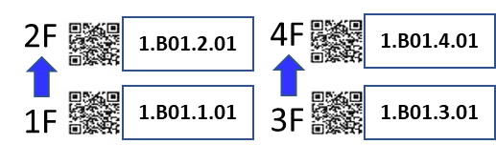
RULE for paste QR code to rack
3/3
Naming rule
1. Pallet/ Trolley (on the ground) QR name position
1.B01A.4.01
01 : Unit location
4 : Floor of rack
01A : Q’ty rack
B : Big rack
S : Small rack
P : Pallet
1 : PSNV first floor
2. Big rack QR name position
3. Small rack QR name position
4F
3F
5th
5th Floor
4th Floor
4th
2F
3rd Floor
3rd
2nd Floor
2nd
1F
1st Floor
1st

Slide 13
Why we choose UAT GR ➔ Convert stock
Convert stock ➔ UAT GR
Convert day
UAT GR
[N-3 day]
[N-2 day]
[N-1 day]
[N day]
[N day]
Part A
Current stock
Convert 1st time
New lot come
Convert 2nd time
1 part convert many time
➔ Hard to control
New lot come
Apply new
No need Convert
Part B
UAT GR ➔ Convert stock
UAT GR
Convert day
[N-3 day]
[N-2 day]
[N-1 day]
[N day]
[N+1 day]
Part A
1 part 1 time convert
Current stock
New lot come
New lot come
Apply new
Part B

